Slide 1
How to create the AI Wolf agent?

Slide 2
Agenda
Preparations for creating the agent
Create the java project
Configure the build path
Javadoc location
Run the game using your agent
Create the seer agent
Notes:
占い師

Slide 3
Prepare for creating the agent

Slide 4
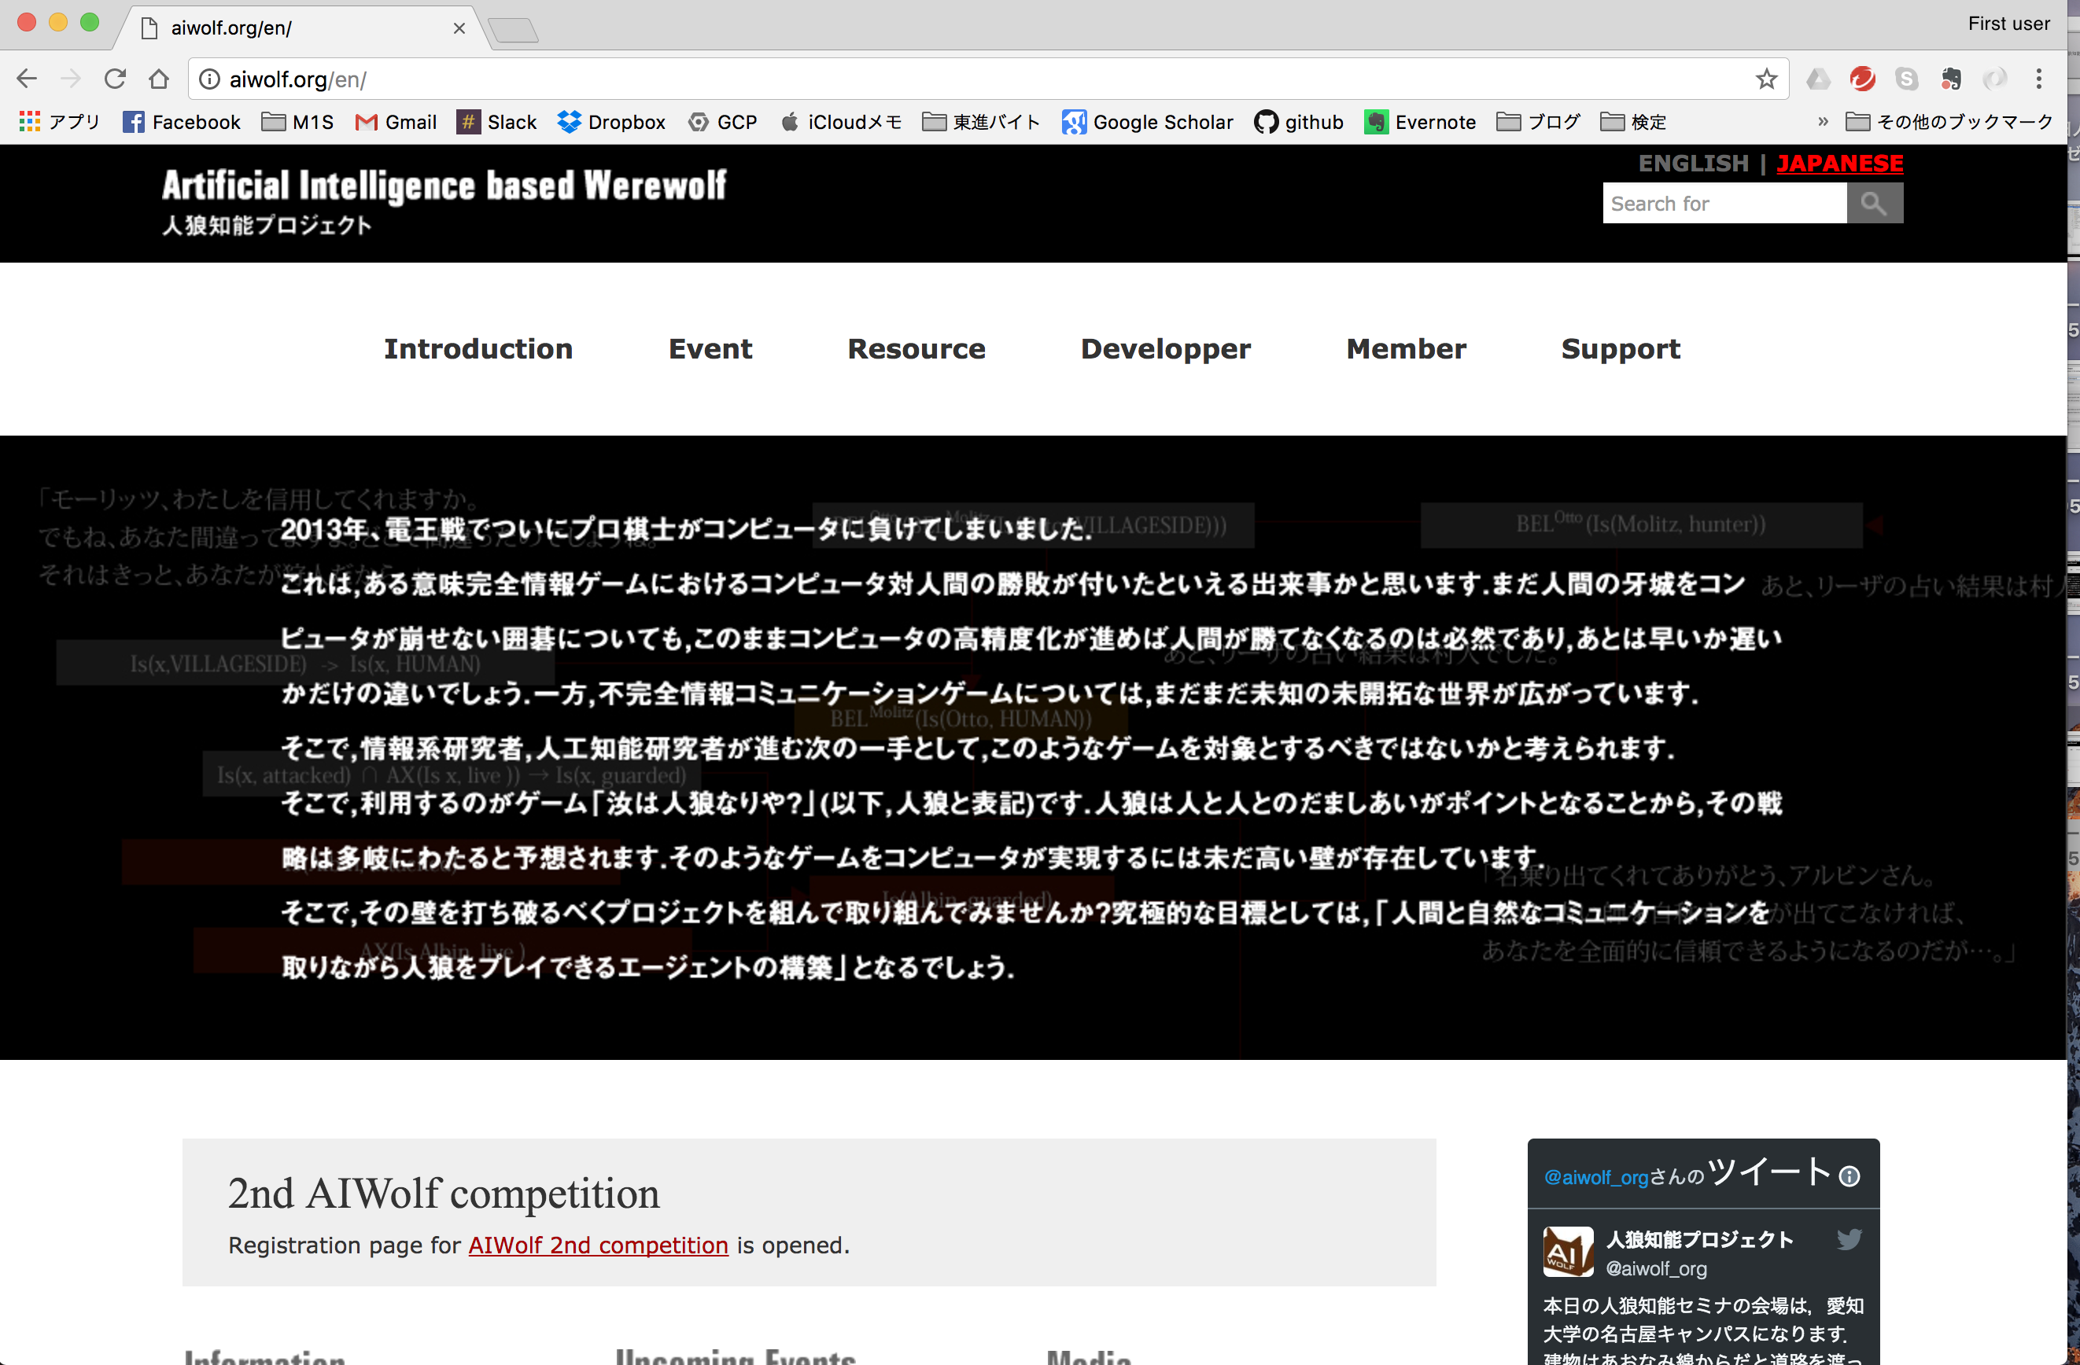
Download the platform（１）
Visit http://aiwolf.org/en
Click “Developer”

Slide 5
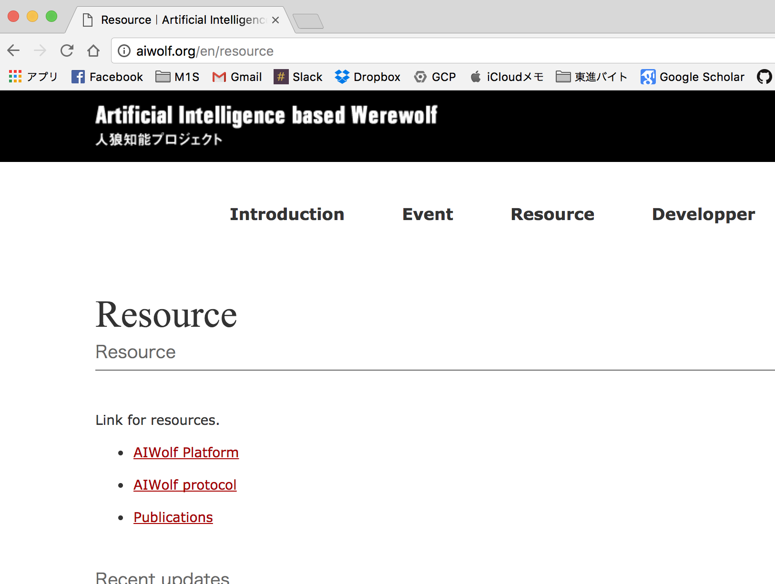
Download the platform（2）
Visit http://aiwolf.org/en
Click “Developer”
Click “AIWolf Platform”

Slide 6
Download the platform（3）
Visit http://aiwolf.org/en
Click “Developer”
Click “AIWolf Platform”
Download aiwolf-ver0.4.9 and java doc
Unzip aiwolf-ver0.4.9

Slide 7
What is a platform（1）
AIWolf-ver0.4.9 Folder
5 JAR file the following files are used to create the agent aiwolf-client.jar , aiwolf-common.jar
4 shell script files(*.sh)
4 batch files(*.bat)
2 files for AutoStarter
(AutoStarter.ini, SampleSetting.cfg)

Slide 8
What is a platform（2）
Summary of the following files
aiwolf-client.jar , aiwolf-common.jar
aiwolf-client.jar
Used for creating the agent
aiwolf-common.jar
Used for creating the agent and running the game

Slide 9
What is a platform（3）
Other files are used for running the game
StartServer starting the game server using GUI
StartClient starting clients which access the game server
StartGUIClient starting clients which access the game server using GUI
AutoStarter running the game by following these files
(AutoStarter.ini and SampleSetting.cfg)

Slide 10
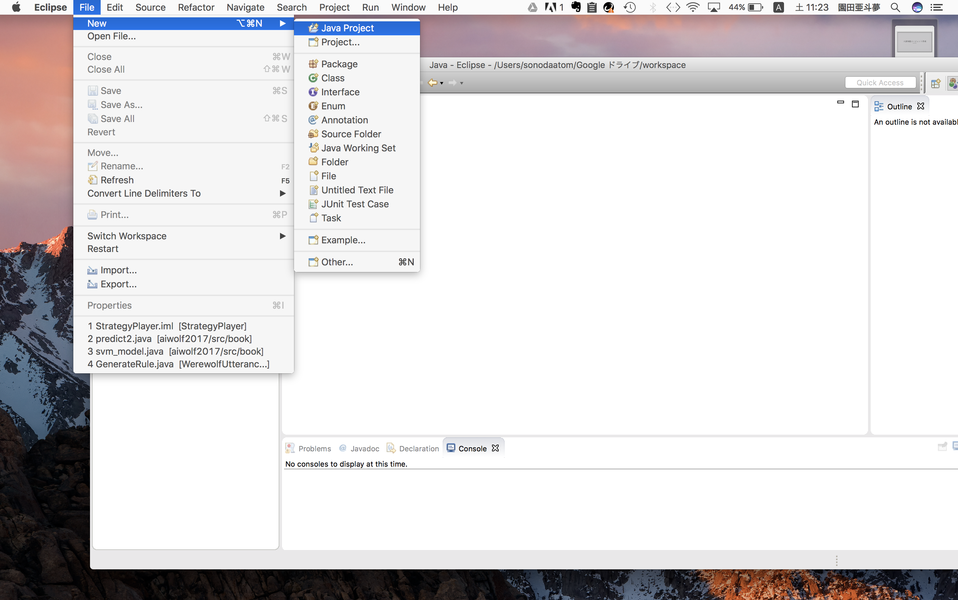
Create the java project（１）
File＞New＞Java Project

Slide 11
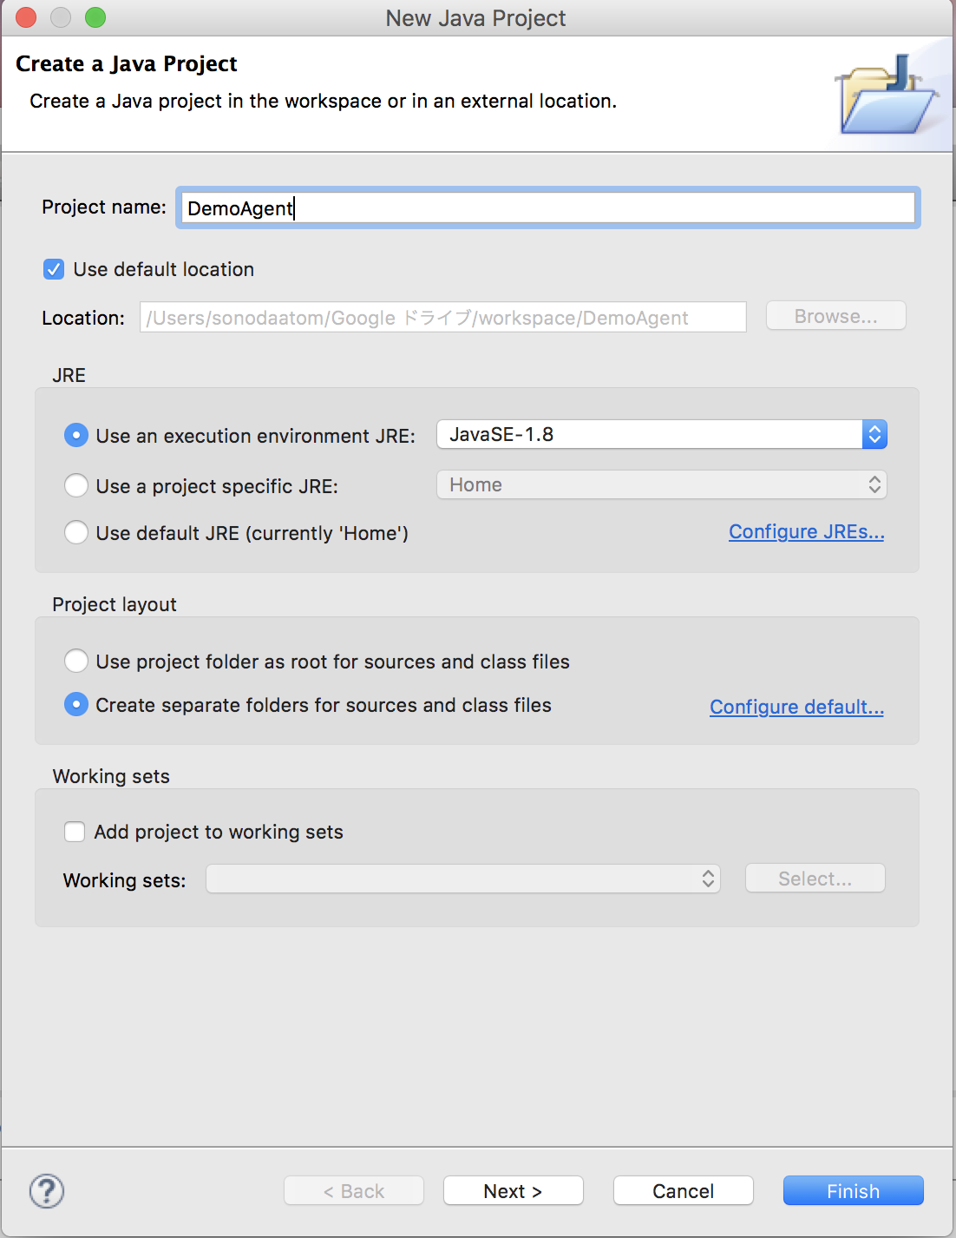
Create the java project （２）
Choose a name for
the project
（Example : DemoAgent）
Then press “Finish”

Slide 12
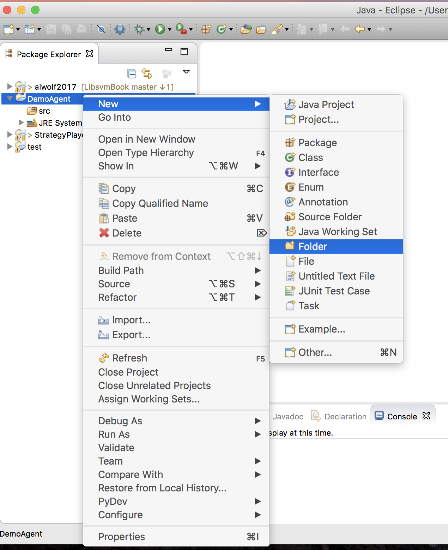
Create the folder（1）
Right-click ＞ New＞Folder

Slide 13
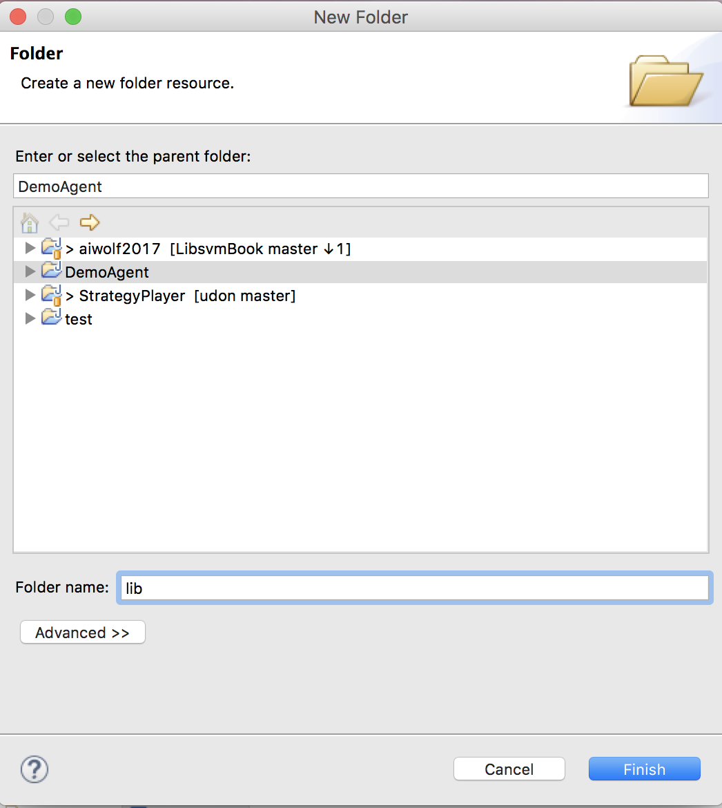
Create the folder （２）
Fill in a suitable name
（Example : lib）
Press “Finish”

Slide 14
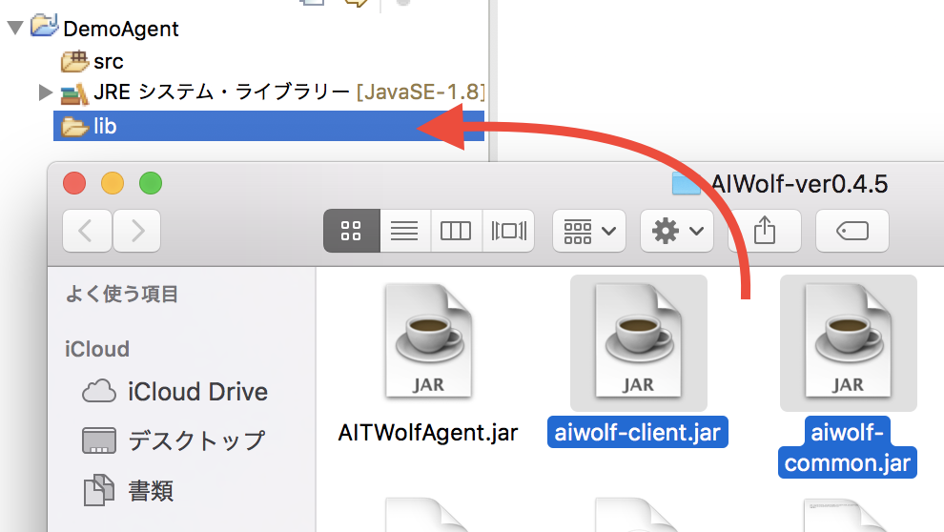
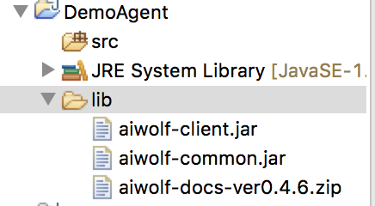
Configure the Build Path（１）
Copy aiwolf-client.jar, aiwolf-common.jar, aiwolf-docs-ver0.4.6.zip to lib

Slide 15
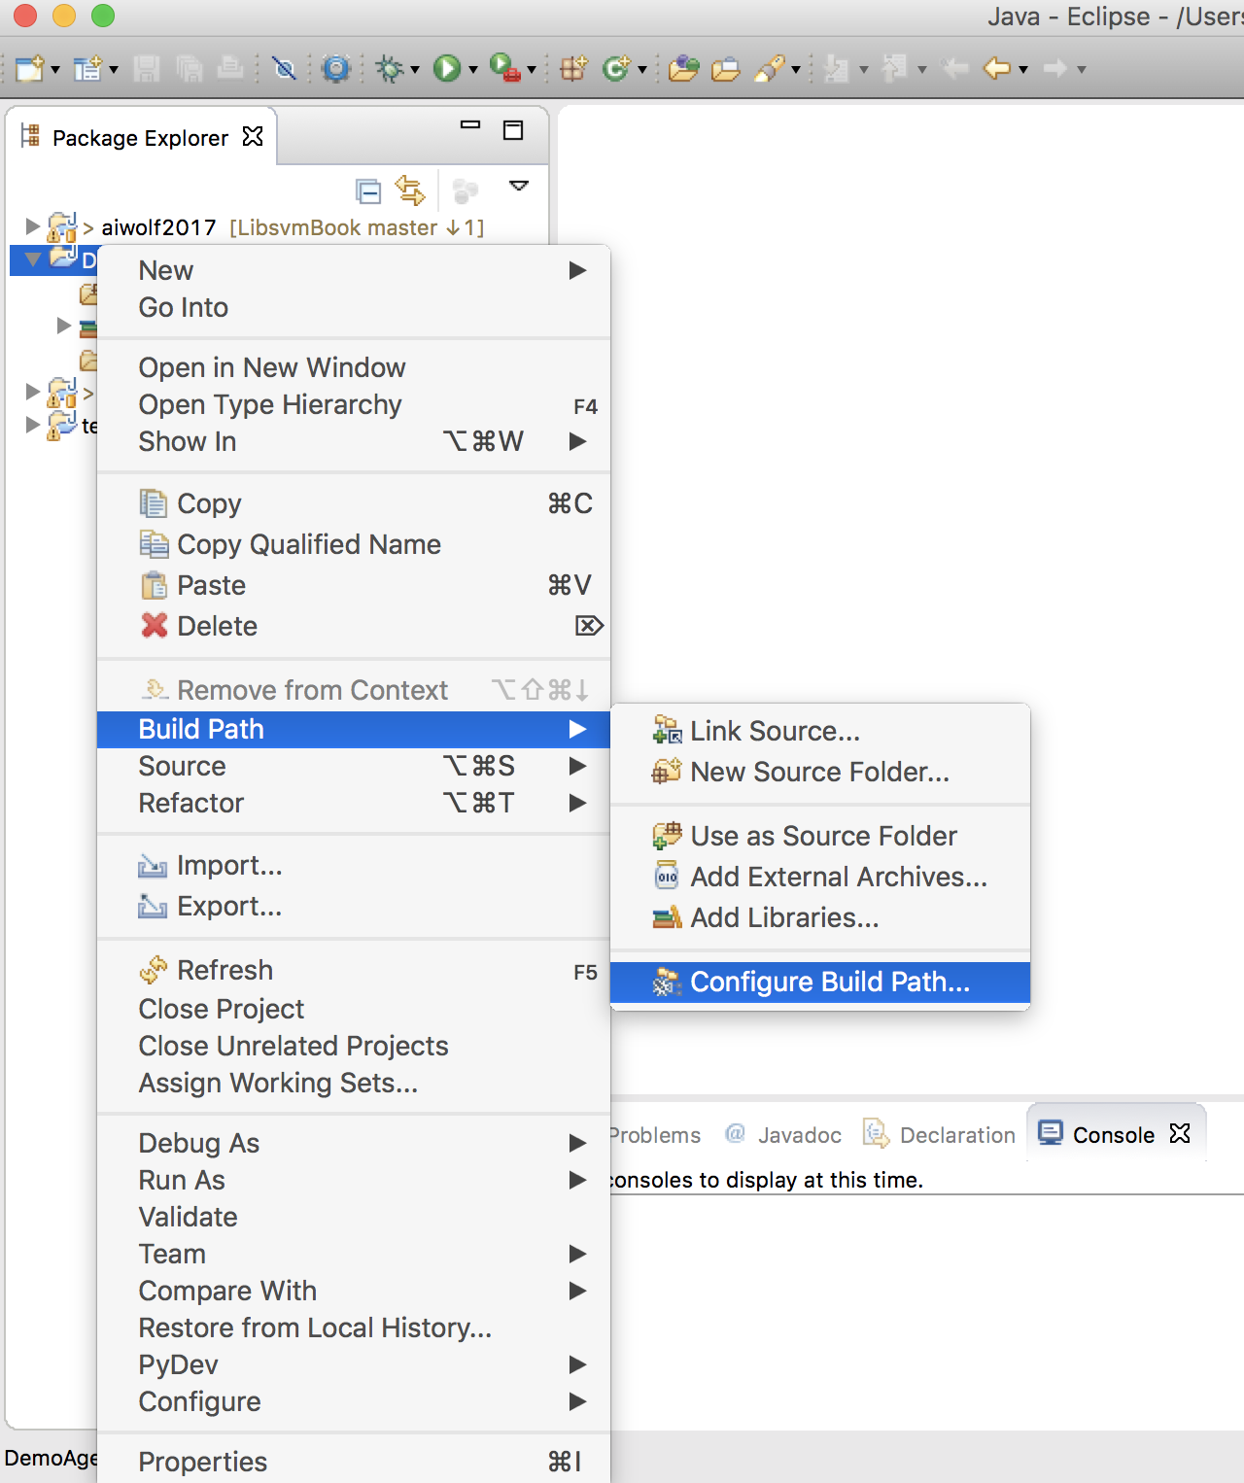
Configure the Build Path（2）
Right-click ＞ Build Path ＞ Configure Build Path

Slide 16
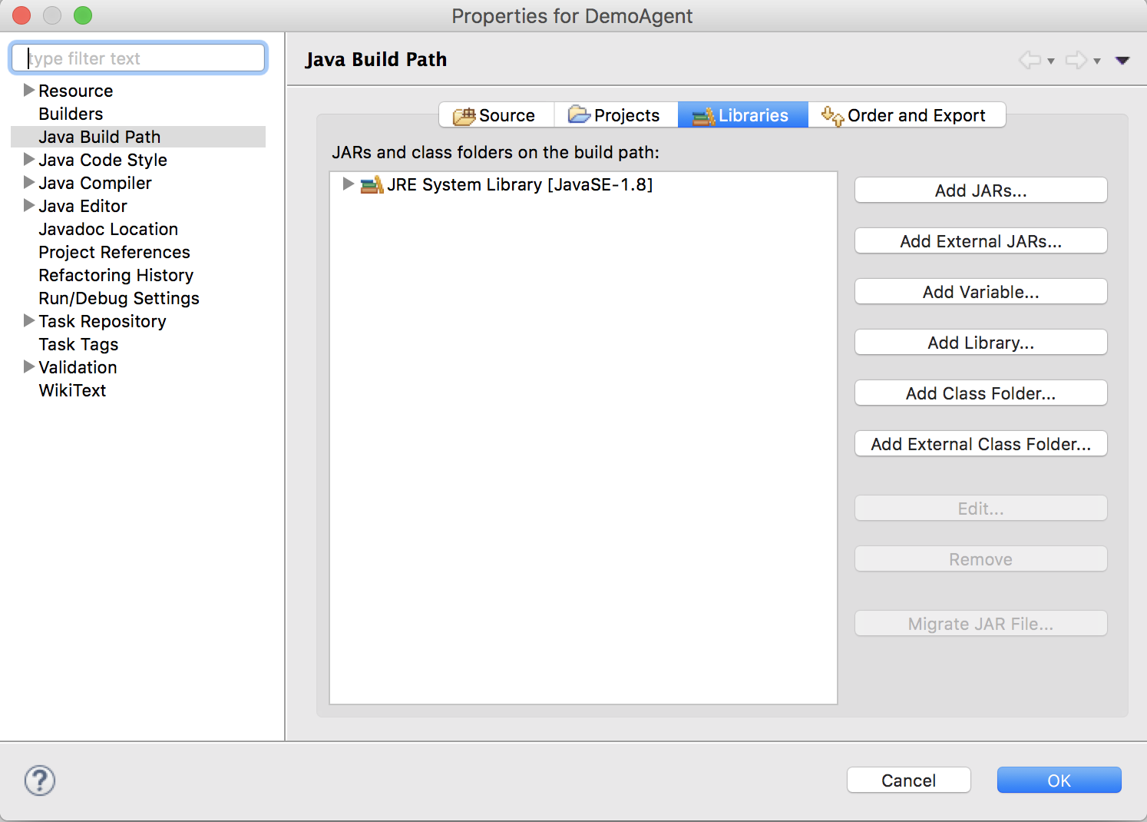
Configure the Build Path（3）
Libraries＞Add JARs..

Slide 17
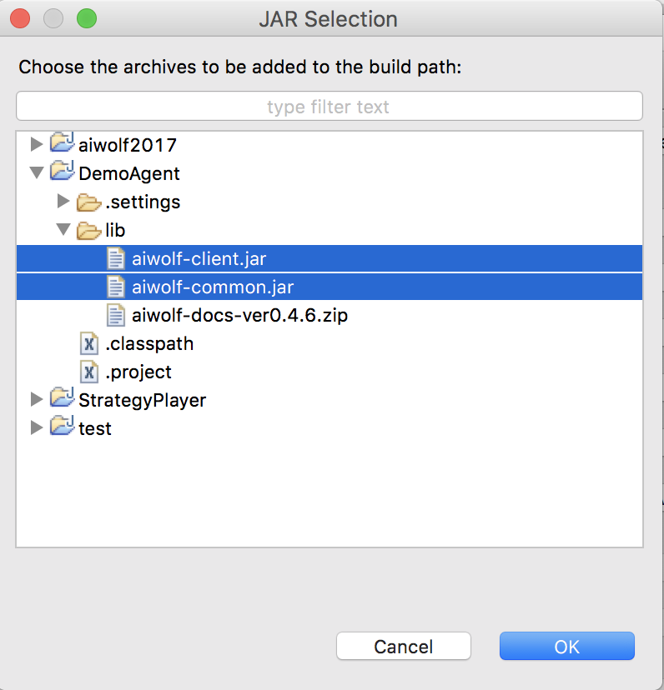
Configure the Build Path（4）
Select 3 jar file from the lib folder
Press “OK”

Slide 18
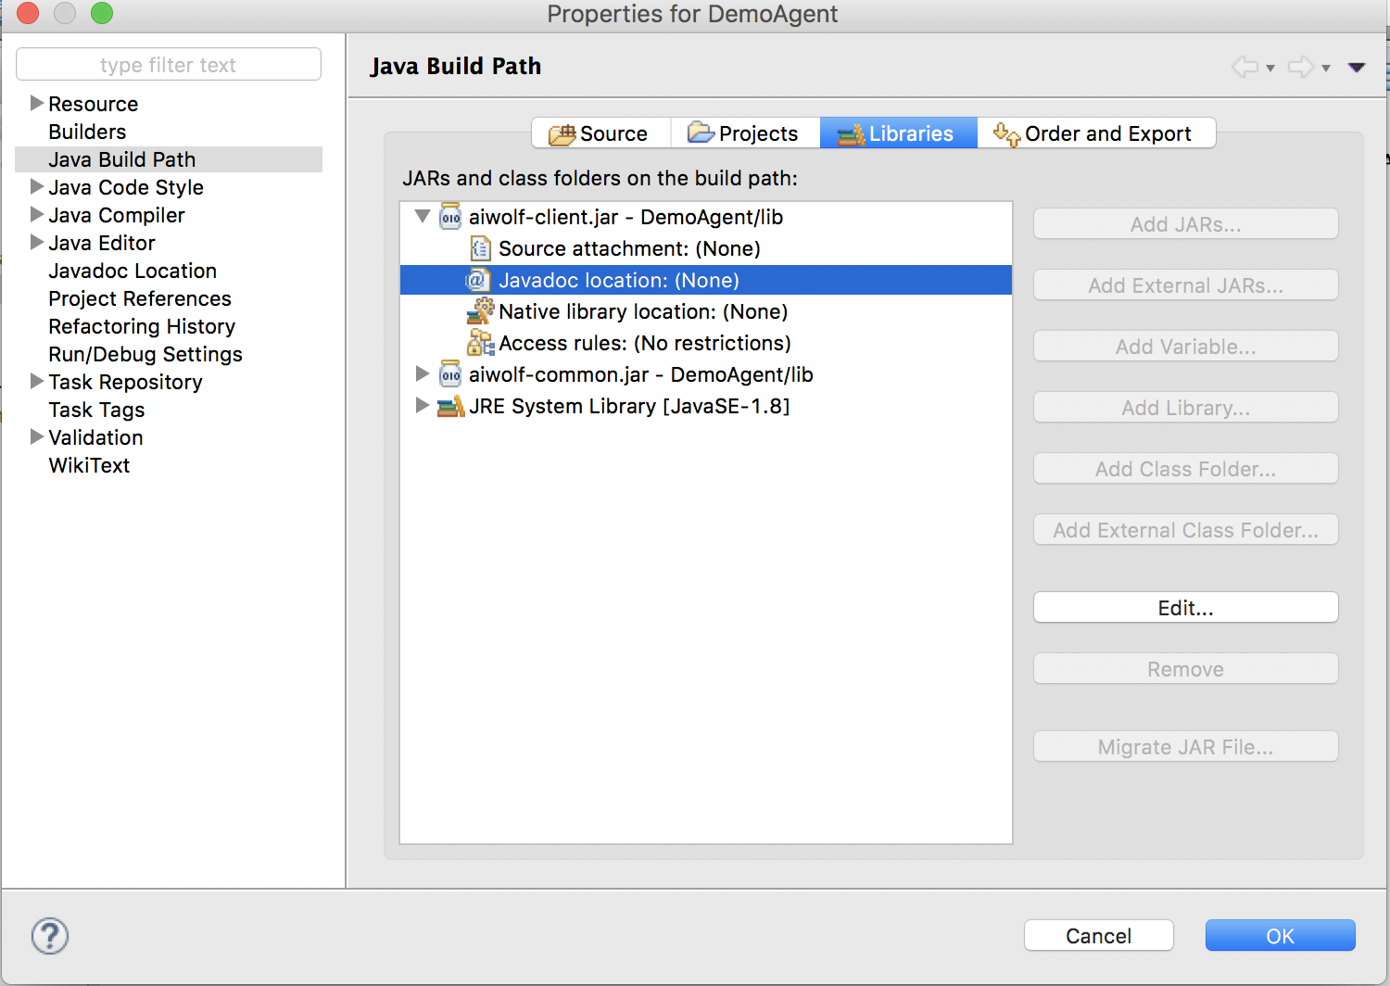
Javadoc location（１）
aiwolf-client.jar＞Javadoc＞Edit..

Slide 19
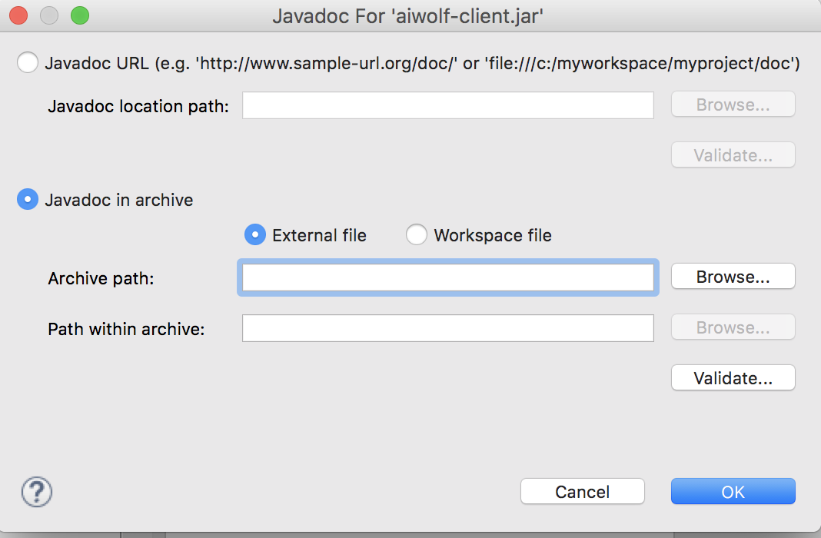
Javadoc location（２）
Javadoc in archive＞External file＞Archive path＞Browse

Slide 20
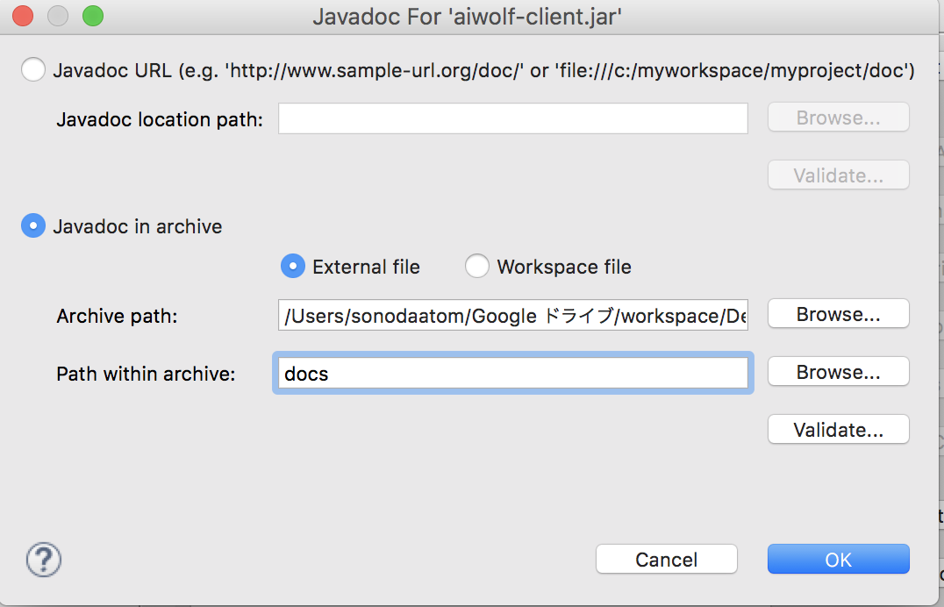
Javadoc location （３）
Browse＞lib ＞ aiwolf-docs-ver0.4.6.zip
Fill in [docs] on Path within archive
Press “Validate”

Slide 21
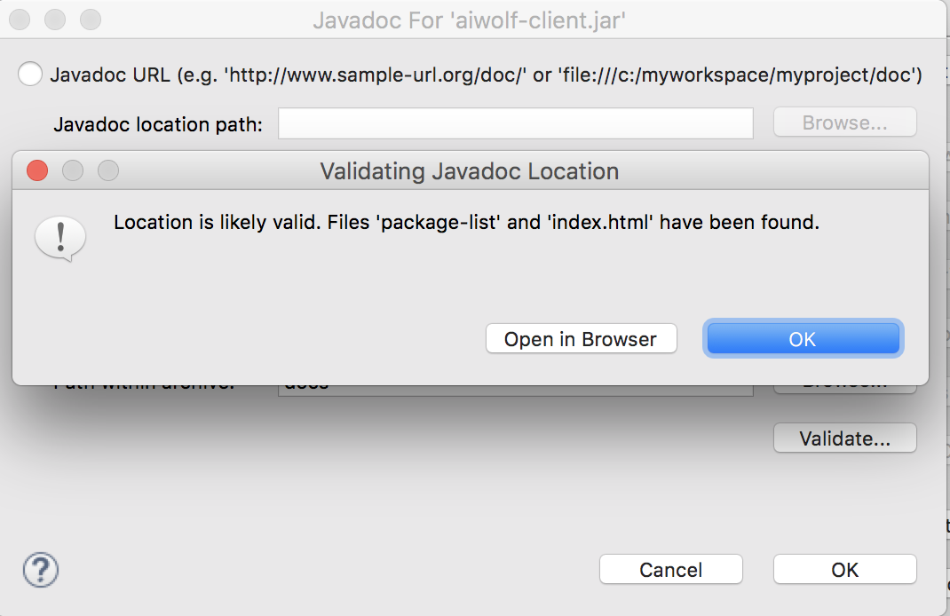
Javadoc location （4）
If you verify the location then ［OK］
Set Javadoc for aiwolf-common.jar in the same way

Slide 22
Create the agent

Slide 23
Run the game with your agent
Creating a class using AbstractRoleAssignPlayer(inheritance)
Preparing for running the game
Creating Agents for each role
Set agents on RoleAssignPlayer

Slide 24
Run the game with your agent
Creating a class using AbstractRoleAssignPlayer(inheritance)
Preparing for running the game
Creating Agents for each role
Set agents on RoleAssignPlayer
First prepare the environment

Slide 25
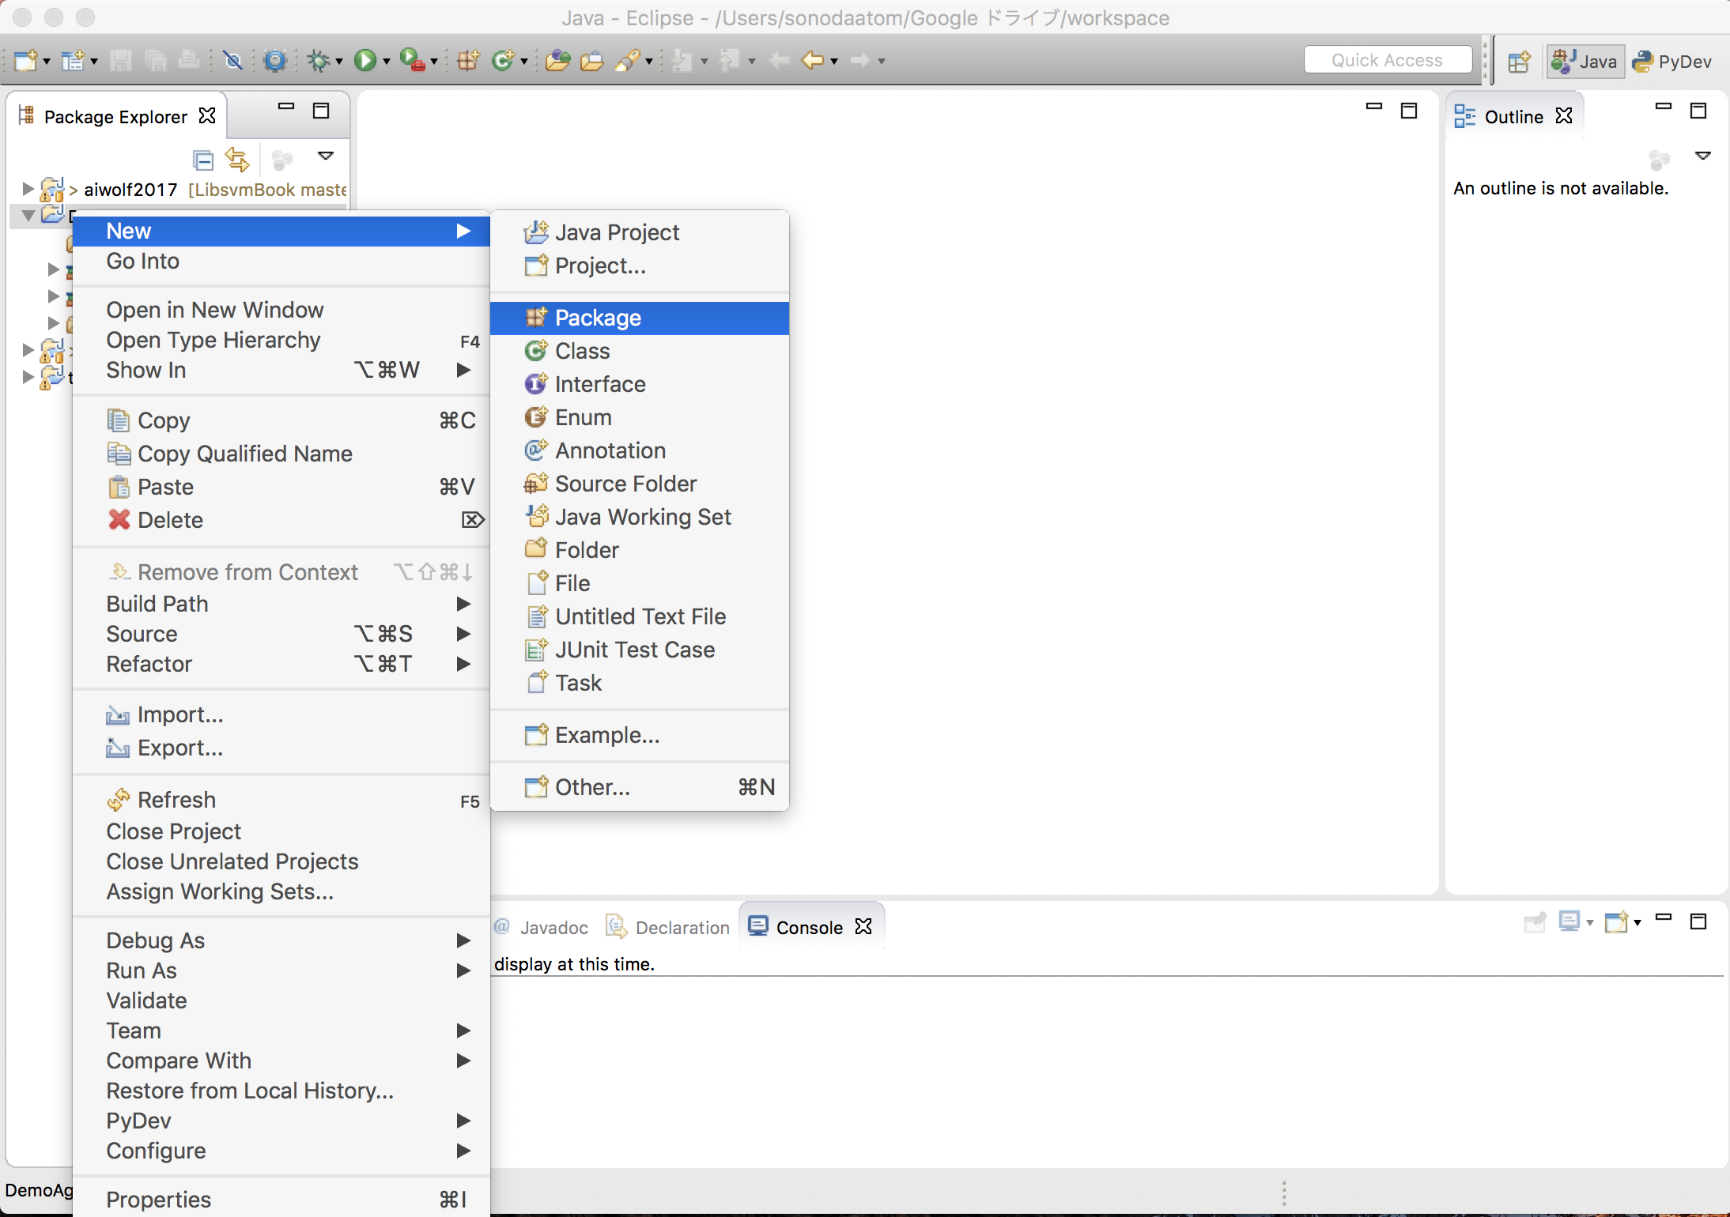
Create Package（１）
DemoAgent＞Right-click ＞ New＞ Package

Slide 26
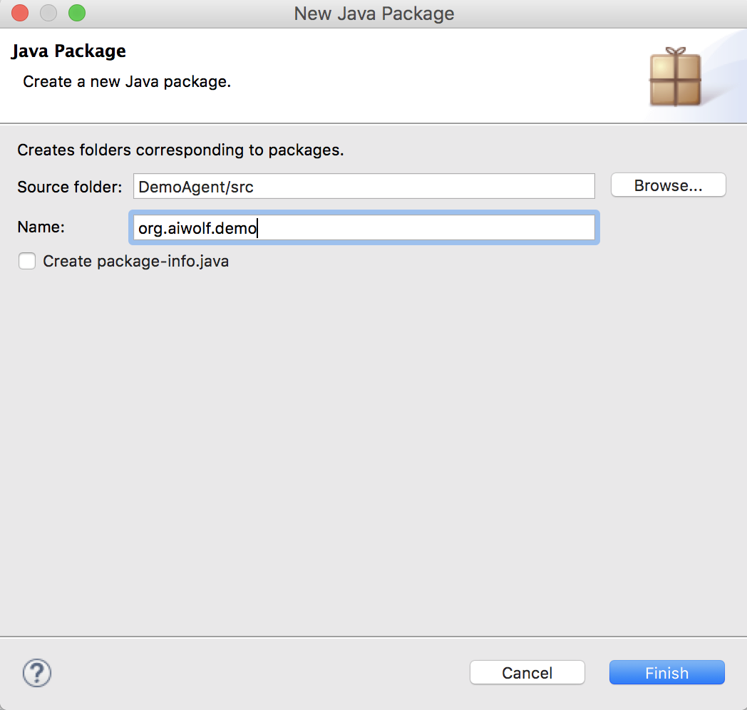
Create Package（2）
Fill in a suitable name
（Example:demo@aiwolf.org→org.aiwolf.demo)
For “Name”
Press “Finish”

Slide 27
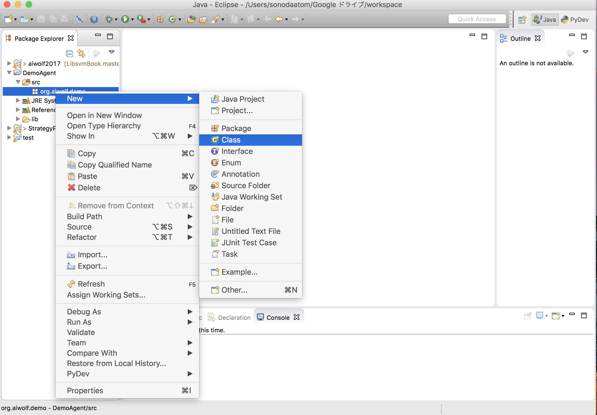
Create Class（１）
org.aiwolf.demo＞Right-click ＞ New＞ Class

Slide 28
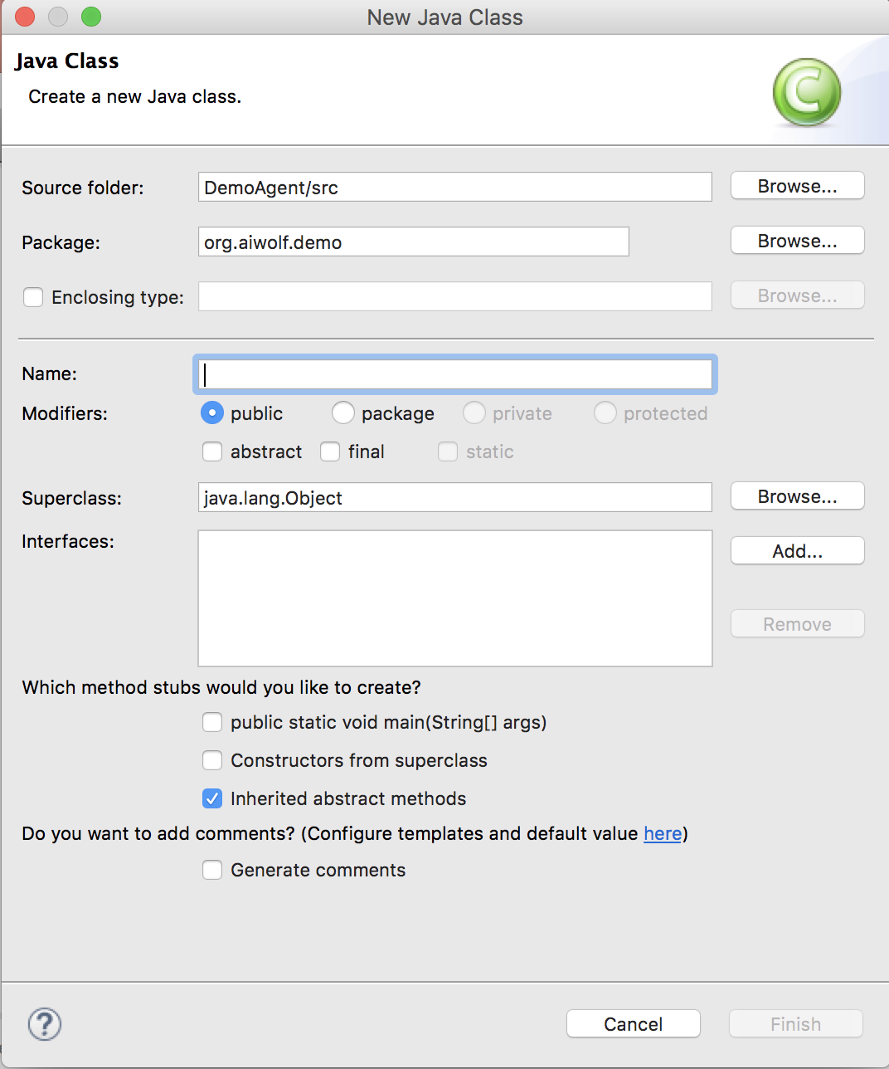
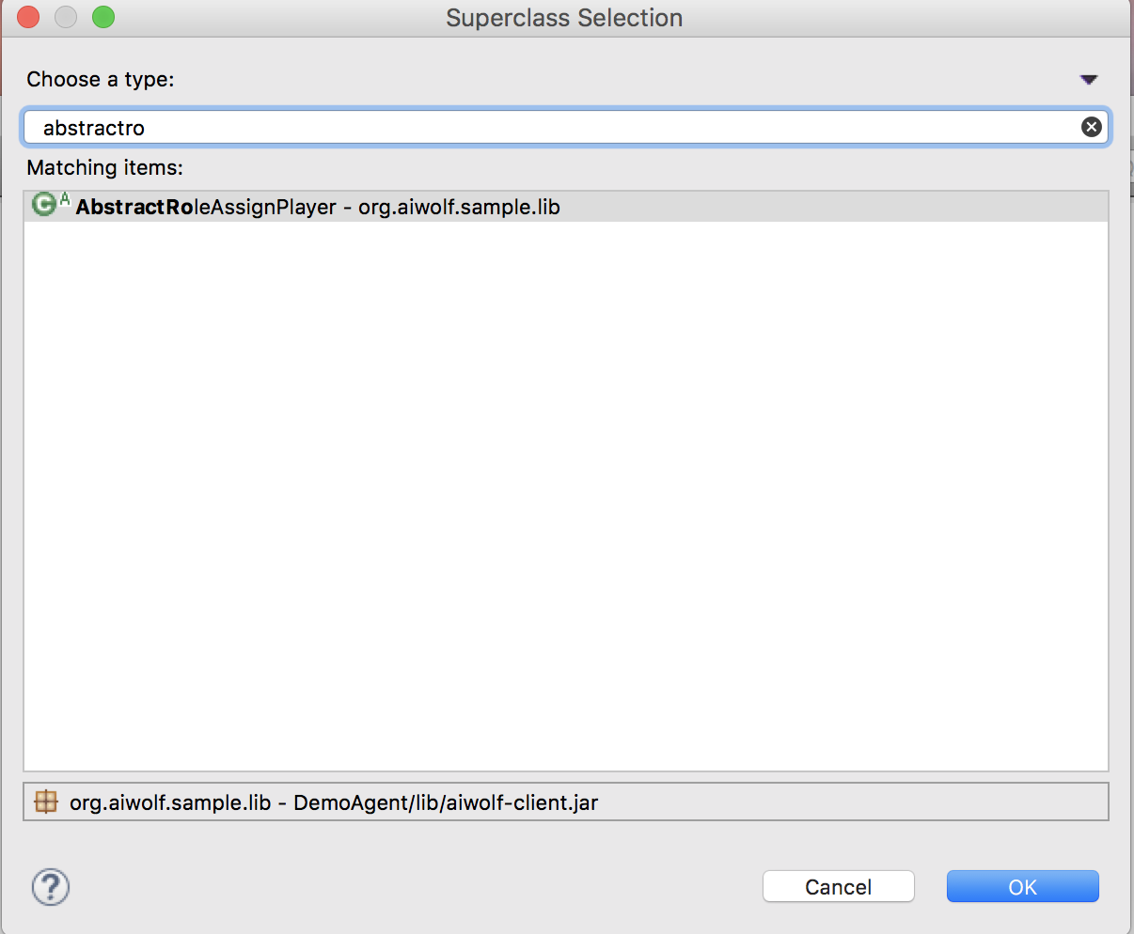
Create Class（2）
Superclass＞Browse
＞ AbstractRoleAssignPlayer - org.aiwolf.sample.lib
And [OK]

Slide 29
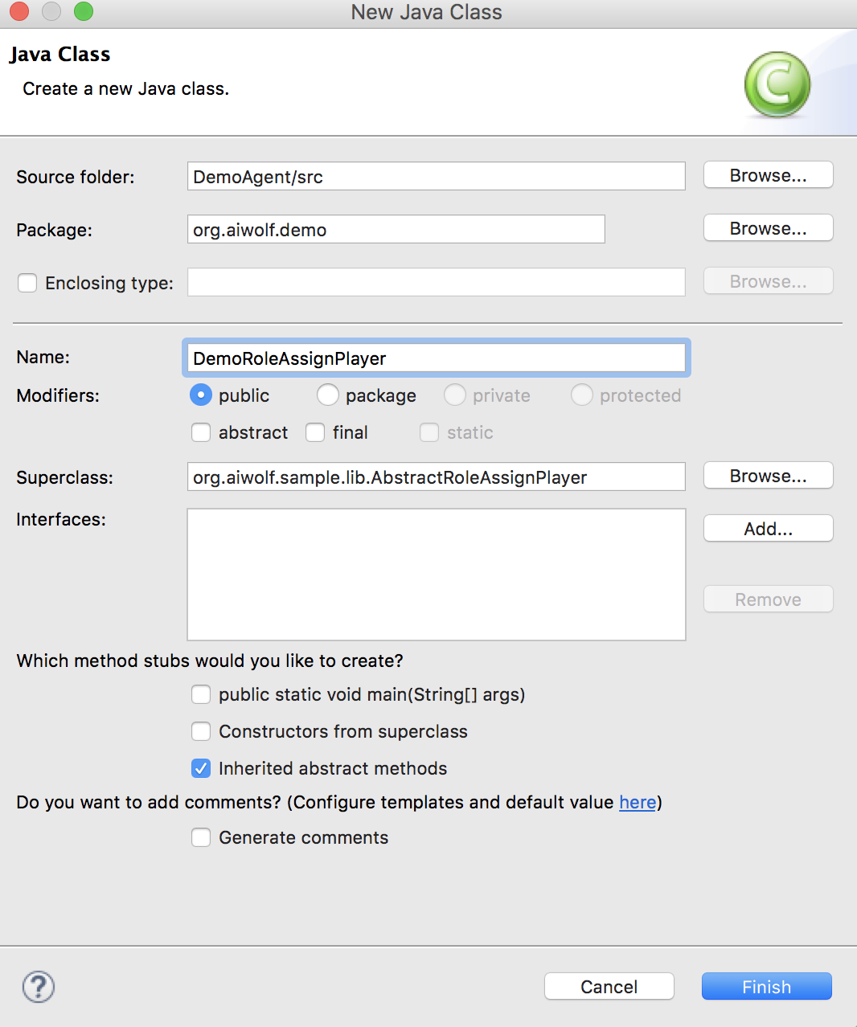
Create Class（３）
Fill in a suitable name
（Example: DemoRoleAssignPlayer)
for “Name”
Press “Finish”
You have already created an agent as strong as sample player

Slide 30
What is a DemoRoleAssignPlayer
Seer class
Medium class
DemoRole
AssignPlayer
Villager class
Werewolf class

Slide 31
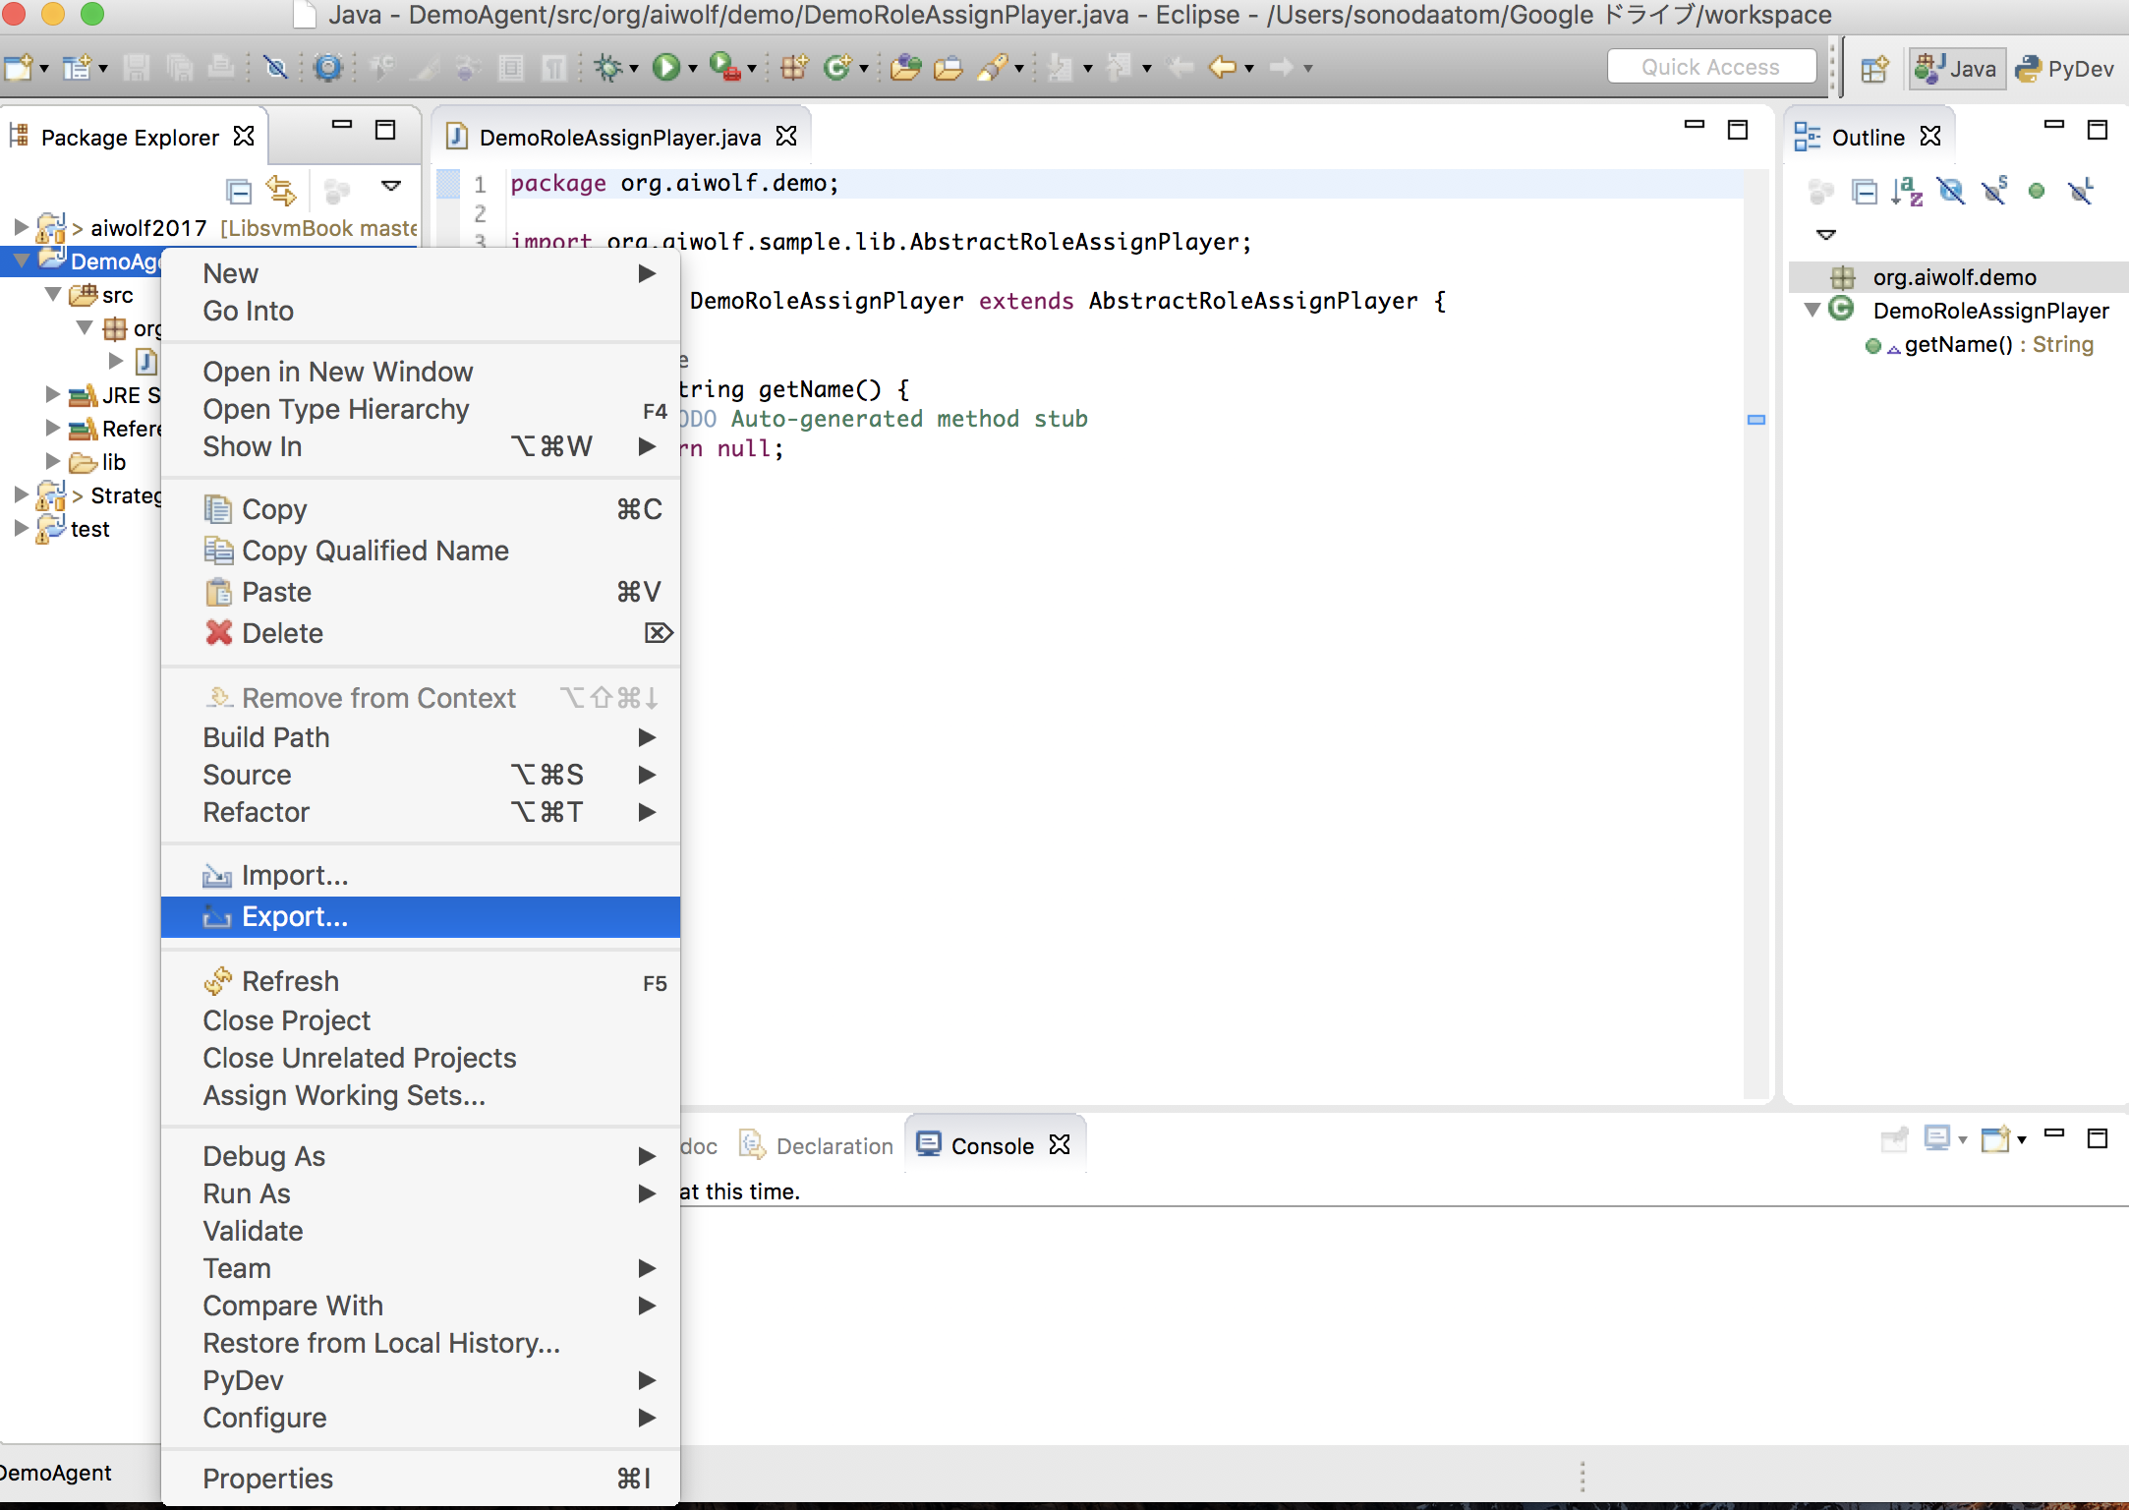
How to make a JAR file（１）
DemoAgent＞Right-click ＞Export

Slide 32
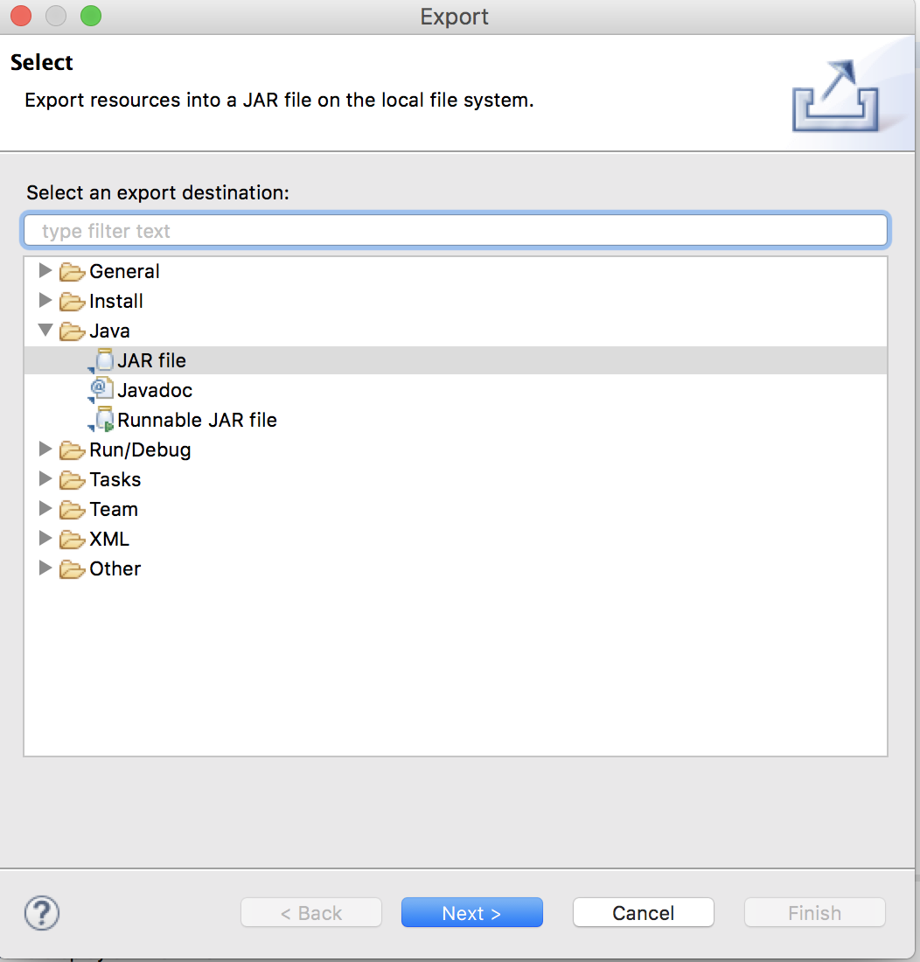
How to make a JAR file（2）
JAVA＞JAR file＞Next

Slide 33
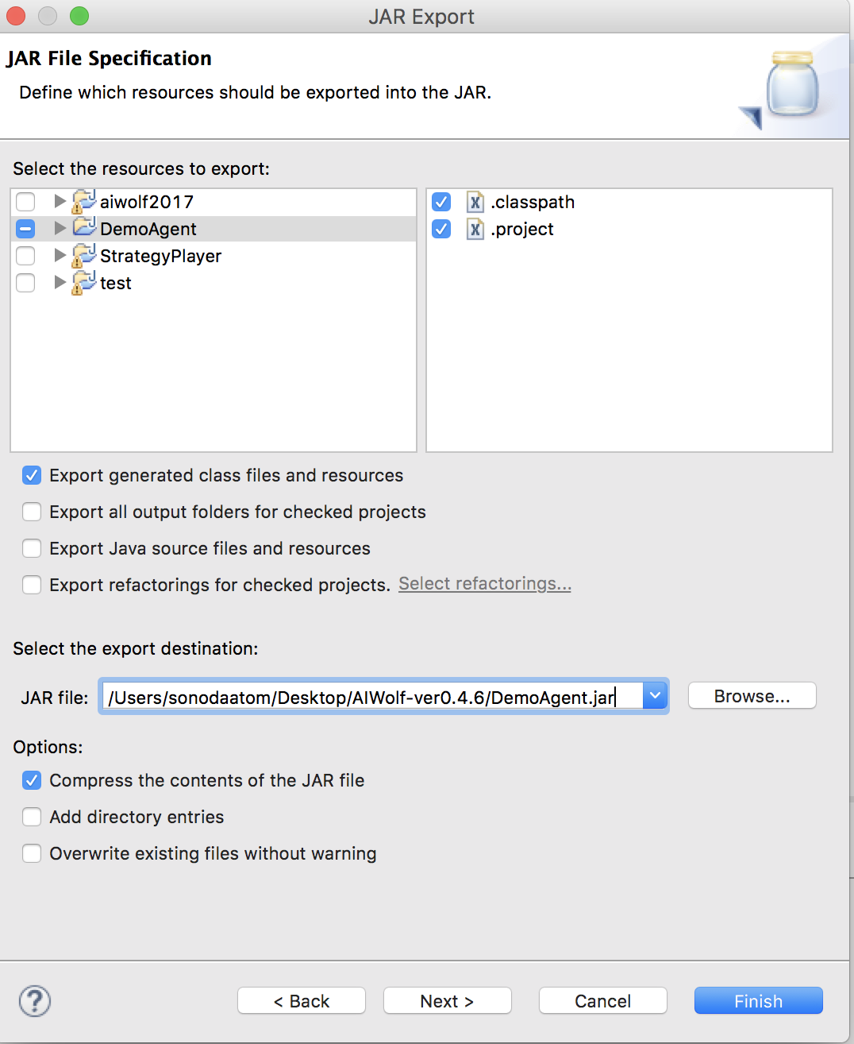
How to make a JAR file（3）
JAR file＞Browse ＞ desktop/AIWolf-ver0.4.9
Fill in a suitable name
（Example: DemoAgent.jar)
on “JAR file”
Press “Finish”

Slide 34
Configurations
Connect some clients(AIWolf agent) to a server and run

Slide 35
Edit .ini
Open AutoStarter.ini
Delete (WEREWOLF,SEER) from Sample1 and Sample2
Comment out Sample5（insert #）
Add the following line on the bottom
[suitable name （Example:Demo）],[package name].[class name]
lib=./
log=./log/
port=10000
game=10
view=true
setting=./SampleSetting.cfg
#agent=5
Sample1,org.aiwolf.sample.player.SampleRoleAssignPlayer
Sample2,org.aiwolf.sample.player.SampleRoleAssignPlayer
Sample3,org.aiwolf.sample.player.SampleRoleAssignPlayer
Sample4,org.aiwolf.sample.player.SampleRoleAssignPlayer
#Sample5,org.aiwolf.sample.player.SampleRoleAssignPlayer
Demo,org.aiwolf.demo.DemoRoleAssignPlayer
Run with 4 sample players and your own agent

Slide 36
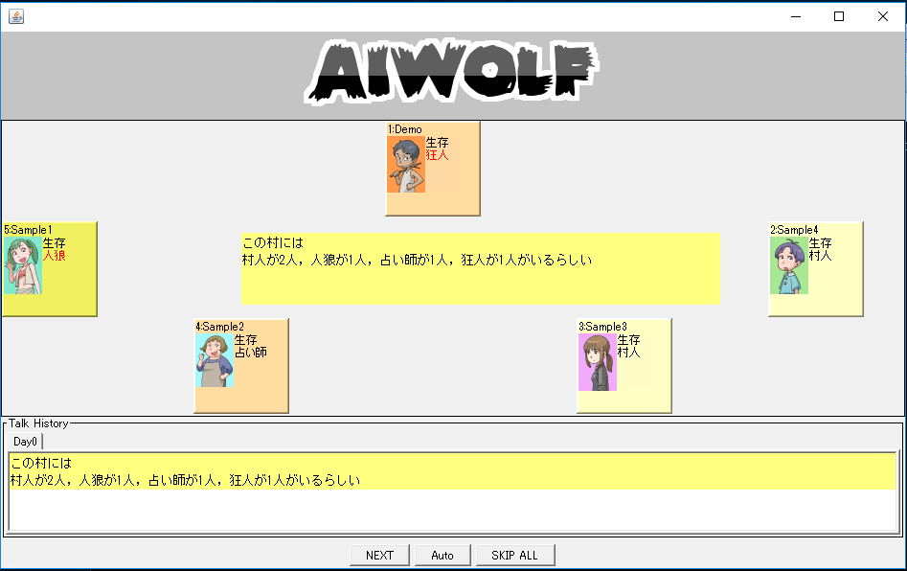
Run the game
Windows : Run AutoStarter.bat
Mac/Linux : Run AutoStarter.sh
Your agent is playing the game

Slide 37
Run the game with your agent
Creating a class using AbstractRoleAssignPlayer(inheritance)
Preparing for running the game
Creating Agents for each role
Set agents on RoleAssignPlayer
Let’s make seer agent

Slide 38
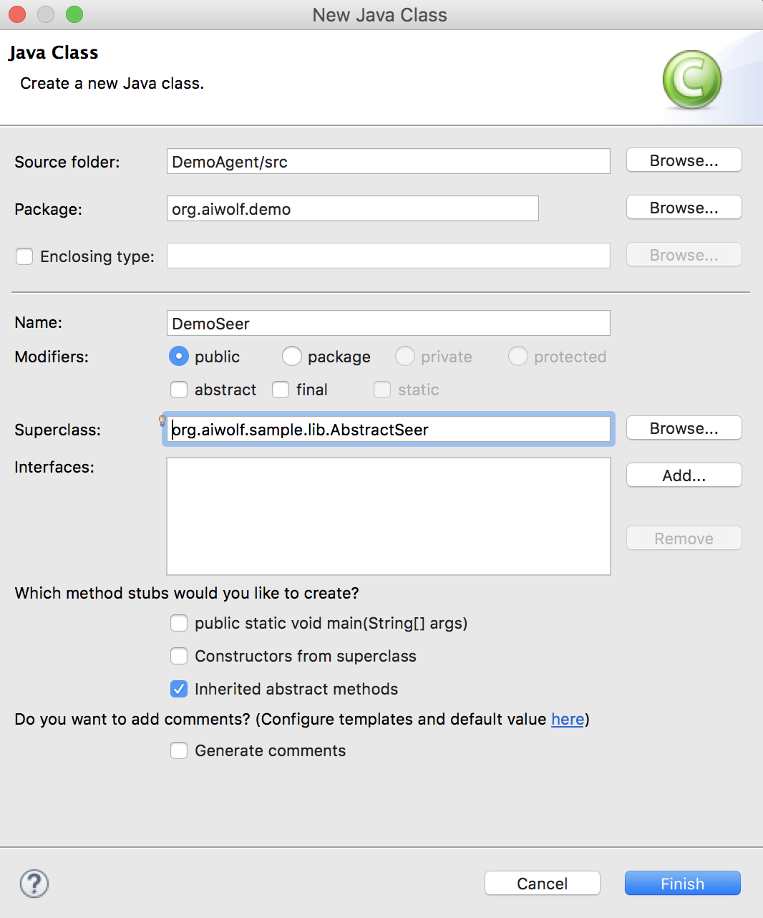
Create a Class for Seer
Create a new class in the same way as RoleAssignPlayer
Name : DemoSeer
Superclass : AbstractSeer
- org.aiwolf.sample.lib

Slide 39
Change RoleAssignPlayer
Add the following constructor to RoleAssignPlayer
When your agent is assigned to seer, agent uses DemoSeer
When your agent is assigned to other roles, agent uses Sample player
public DemoRoleAssignPlayer(){
setSeerPlayer(new DemoSeer());
}

Slide 40
Run the game
After you export JAR file and run AutoStarter, confirm whether the program is running or not.
DemoSeer has no method so does nothing
What kind of methods
should you implement？

Slide 41
Player Interface
Methods defined in Player interface
Server calls these methods each time
Update is called just before each method except for initialize
initialize(GameInfo, GameSetting)
update(GameInfo) | getName()
dayStart() | talk()
whisper() | vote()
attack() | divine()
guard() | finish()

Slide 42
Stream of the Game
initialize
dayStart
First Day？
YES
NO
Day time talk
vote
whisper（ only werewolf ）
divine（only seer）
Every day
Night
divine（only seer）
whisper（only werewolf）
guard（only guardian）
attack（only werewolf）
NO
End？
YES
finish
At night, you can use the result of votting

Slide 43
Return of each method
void
String
Agent（method to select target agent）
initialize(GameInfo, GameSetting)
update(GameInfo)
dayStart()
finish()
getName() | talk() | whisper()
vote() | attack() | divine() | guard()

Slide 44
Create the Seer Agent
AbstractSeer
The following methods are not inherited:
attack(), guard(), whisper(). They are useless for seer.
Implement other methods

Slide 45
Let’s create the seer agent

Slide 46
Implementation
Define fields and utility methods
Implement [getName], [update]
Implement [initialize]
Implement [dayStart]
Implement [vote]：voting depends on the result of divining
Implement [divine]：divining randomly
Implement [talk]：coming-out，talking about the result of divining

Slide 47
Implementation
Define fields and utility methods
Implement [getName], [update]
Implement [initialize]
Implement [dayStart]
Implement [vote]：voting depends on the result of divining
Implement [divine]：divining randomly
Implement [talk]：coming-out，talking about the result of divining

Slide 48
Field
/** me */
Agent me;
/** newest GameInfo */
GameInfo currentGameInfo;
/** list of divining results which have never reported */
Deque<Judge> myDivinationQueue = new LinkedList<>();
/** list of human */
List<Agent> whiteList = new ArrayList<>();
/** list of werewolf */
List<Agent> blackList = new ArrayList<>();
/** list of gray */
List<Agent> grayList;
/** whether you have done coming-out or not */
boolean isCO = false;
/** GameInfo.talkList */
int talkListHead; // initialize at dayStart()
/** Coming-out information */
Map<Agent, Role> comingoutMap = new HashMap<>(); // initialize at initialize

Slide 49
Utility method
/** whether agent is alive or not */
boolean isAlive(Agent agent) {
return currentGameInfo.getAliveAgentList().contains(agent);
}
/** return form list at random */
<T> T randomSelect(List<T> list) {
if (list.isEmpty()) {
return null;
} else {
return list.get((int) (Math.random() * list.size()));
}
}

Slide 50
Implementation
Define fields and utility methods
Implement [getName], [update]
Implement [initialize]
Implement [dayStart]
Implement [vote]：voting depends on the result of divining
Implement [divine]：divining randomly
Implement [talk]：coming-out，talking about the result of divining

Slide 51
getName(), update()
public String getName() {
return "DemoSeer";
}
public void update(GameInfo gameInfo) {
//updating currentGameInfo
currentGameInfo = gameInfo;
}

Slide 52
Implementation
Define fields and utility methods
Implement [getName], [update]
Implement [initialize]
Implement [dayStart]
Implement [vote]：voting depends on the result of divining
Implement [divine]：divining randomly
Implement [talk]：coming-out，talking about the result of divining

Slide 53
initialize()
Initialize field
Avoiding remaining old game information
public void initialize(GameInfo gameInfo,
GameSetting gameSetting) {
// initializing field
me = gameInfo.getAgent();
grayList = new ArrayList<>(gameInfo.getAgentList());
grayList.remove(me);
whiteList.clear();
blackList.clear();
myDivinationQueue.clear();
}

Slide 54
Implementation
Define fields and utility methods
Implement [getName], [update]
Implement [initialize]
Implement [dayStart]
Implement [vote]：voting depends on the result of divining
Implement [divine]：divining randomly
Implement [talk]：coming-out，talking about the result of divining

Slide 55
dayStart()
public void dayStart() {
// getting result of divining
Judge divination = currentGameInfo.getDivineResult();
if (divination != null) {
myDivinationQueue.offer(divination);
Agent target = divination.getTarget();
Species result = divination.getResult();
// updating gray・white・black list
grayList.remove(target);
if (result == Species.HUMAN) {
whiteList.add(target);
} else {
blackList.add(target);
}
}
//initializing
talkListHead=0;
}

Slide 56
Implementation
Define fields and utility methods
Implement [getName], [update]
Implement [initialize]
Implement [dayStart]
Implement [vote]：voting depends on the result of divining
Implement [divine]：divining randomly
Implement [talk]：coming-out，talking about the result of divining

Slide 57
vote()
Vote from alive werewolf at random
If there is no alive werewolf, vote from alive gray agents at random

Slide 58
vote()
public Agent vote() {
// list of candidates
List<Agent> candidates = new ArrayList<>();
// adding alive werewolf to candidates
for (Agent agent : blackList) {
if (isAlive(agent)) {
candidates.add(agent);
}
}
// If there is no agent in candidates, adding alive gray player to candidates
if (candidates.isEmpty()) {
for (Agent agent : grayList) {
if (isAlive(agent)) {
candidates.add(agent);
}
}
}
続く

Slide 59
vote()
// If there is no agent in candidates, return null
//（voting at random from alive agent except for me）
if (candidates.isEmpty()) {
return null;
}
// voting at random from candidates
return randomSelect(candidates);
}

Slide 60
vote() （whole code）
public Agent vote() {
// list of candidates
List<Agent> candidates = new ArrayList<>();
// adding alive werewolf to candidates
for (Agent agent : blackList) {
if (isAlive(agent)) {
candidates.add(agent);
}
}
// If there is no agent in candidates, adding alive gray player to candidates
if (candidates.isEmpty()) {
for (Agent agent : grayList) {
if (isAlive(agent)) {
candidates.add(agent);
}
}
}
// If there is no agent in candidates, return null
//（voting at random from alive agent except for me）
if (candidates.isEmpty()) {
return null;
}
// voting at random from candidates
return randomSelect(candidates);
}
Go to divine()

Slide 61
Implementation
Define fields and utility methods
Implement [getName], [update]
Implement [initialize]
Implement [dayStart]
Implement [vote]：voting depends on the result of divining
Implement [divine]：divining randomly
Implement [talk]：coming-out，talking about the result of divining

Slide 62
divine()
Select from alive agents which have never been divined except for itself at random

Slide 63
divine()
public Agent divine() {
// list of candidates
List<Agent> candidates = new ArrayList<>();
// adding alive gray player to candidates
for (Agent agent : grayList) {
if (isAlive(agent)) {
candidates.add(agent);
}
}
// don't divine if there is no agent in candidates
if (candidates.isEmpty()) {
return null;
}
// divining at random from candidates
return randomSelect(candidates);
}
Go to talk

Slide 64
Implementation
Define fields and utility methods
Implement [getName], [update]
Implement [initialize]
Implement [dayStart]
Implement [vote]：voting depends on the result of divining
Implement [divine]：divining randomly
Implement [talk]：coming-out，talking about the result of divining

Slide 65
talk, whisper
Server calls talk() method by turn
Turn 1 ~ 20

Slide 66
talk, whisper
2 class used for talk
org.aiwolf.client.lib.Content Classs
org.aiwolf.client.lib.ContentBuilder sub Class
Making utterance by following process
ContentBuilder builder = ContentBuilder(for each subject);
Content content = new Content(builder);
String text = content.getText();

Slide 67
ContentBuilder Class(1)
EstimateContentBuilder(target, role): estimating target’s role to be certain role
ComingoutContentBuilder (target, role) : coming out target’s role as certain role
DivinationContentBuilder(target) : divining target
DivinedResultContentBuilder(target, result) : divining target and reporting result
IdentContentBuilder(target, result) : identifiying target and reporting result
GuardCandidateContentBuilder(target) : guarding target
GuardedAgentContentBuilder(target) : guarded
targetVoteContentBuilder(target) : voting for target
AttackContentBuilder(target) : attacking
targetAgreeContentBuilder(talkType, talkDay, talkID) : agreeing on utterance(talkDay，talkType，talkID)

Slide 68
ContentBuilder Class(2)
DisagreeContentBuilder(talkType, talkDay, talkID) : disagreeing on utterance(talkDay，talkType，talkID)
RequestContentBuilder(agent, content) : asking agent talk content
OverContentBuilder() : there is no content OVER = new Content(new OverContentBuilder());
SkipContentBuilder() : seeing how things go SKIP = new Content(new SkipContentBuilder());

Slide 69
Example
Making content reporting divine result
//getting divine result
Judge judge = getLatestDayGameInfo().getDivineResult();
//making content
ContentBuilder builder = new
DivinedResultContentBuilder(judge.getTarget(), judge.getResult();
String talk = new Content(builder).getText();

Slide 70
talk()
Coming out if you find werewolf
After coming out, reporting divine result

Slide 71
talk()
public String talk() {
// coming out if you find werewolf
if (!isCO) {
if (!myDivinationQueue.isEmpty() &&
myDivinationQueue.peekLast().getResult() == Species.WEREWOLF) {
isCO = true;
ContentBuilder builder = new ComingoutContentBuilder(me, Role.SEER);
return new Content(builder).getText();
}
}
To be continued

Slide 72
talk()
// After coming out, reporting divine result
else {
if (!myDivinationQueue.isEmpty()) {
Judge divination = myDivinationQueue.poll();
//making content
ContentBuilder builder = new DivinedResultContentBuilder(divination.getTarget(),
divination.getResult());
return new Content(builder).getText();
}
}
return Content.OVER.getText();
}

Slide 73
talk() （whole code）
public String talk() {
// coming out if you find werewolf
if (!isCO) {
if (!myDivinationQueue.isEmpty() &&
myDivinationQueue.peekLast().getResult() == Species.WEREWOLF) {
isCO = true;
ContentBuilder builder = new ComingoutContentBuilder(me, Role.SEER);
return new Content(builder).getText();
}
}
// After coming out, reporting divine result
else {
if (!myDivinationQueue.isEmpty()) {
Judge divination = myDivinationQueue.poll();
//making content
ContentBuilder builder = new DivinedResultContentBuilder(divination.getTarget(),
divination.getResult());
return new Content(builder).getText();
}
}
return Content.OVER.getText();
}
Let’s read other’s content

Slide 74
Read the Content
List of content is got by GameInfo.getTalkList() as List<Talk> Type
Talk class method
getAgent()：getting Agent which is talking
getText()：getting Content （String）
getDay()：getting day（int）
getIdx()：getting order (int） of the day
getTurn()：getting turn （int） of the day

Slide 75
Read the Content
String from Talk.getText() are based on AIWolf protocol
Example：“DIVINED Agent[04] HUMAN”
In order to parse the String，get the String to constructor of Content class
//In order to parse the String， get the String to constructor of Content class
Content content = new Content(talk.getText());

Slide 76
Content Class
return value | Method name | Description
String | getText() | Return content as it is
Operator | getOperator() | Return operator of content．If the content is simple sentence, then return null
Agent | getSubject() | Return subject
Topic | getTopic() | Return topic （COMINGOUT, DIVINED…）
Agent | getTarget() | Return target （Example:”DIVINED Agent[01] HUMAN” → Agent[01]）
Role | getRole() | Return role（Example:”COMINGOUT Agent[02] SEER” → SEER）
Species | getResult() | Return result of divine or identificatiion（Example:”IDENTIFIED Agent[03] WEREWOLF” → WEREWOLF）
TalkType | getTalkType() | If Topic is AGREE/DISAGREE，return type（TALK/WHISPER）
int | getTalkDay() | If Topic is AGREE/DISAGREE，return day（TALK/WHISPER）
int | getTalkID() | If Topic is AGREE/DISAGREE，return id（TALK/WHISPER）
List<Content> | getContentList() | If the content is a complex sentence, then return list of passage

Slide 77
To read content, Correcting update() （１）
public void update(GameInfo gameInfo) {
// updating currentGameInfo
currentGameInfo = gameInfo;
// From GameInfo.talkList, getting CO・divine report・identifying report
for (int i = talkListHead; i < currentGameInfo.getTalkList().size(); i++) {
Talk talk = currentGameInfo.getTalkList().get(i);
Agent talker = talk.getAgent();
if (talker == me) {
continue;
}
Content content = new Content(talk.getText()); // parse content
To be continued

Slide 78
To read content, Correcting update() （2）
switch (content.getTopic()) {
case COMINGOUT: // processing Coming-out
// reading Coming-out
comingoutMap.put(talker, content.getRole());
break;
case DIVINED: // processing divine result
break;
case IDENTIFIED: // processing identifying result
break;
default:
break;
}
}
talkListHead = currentGameInfo.getTalkList().size();
}

Slide 79
update()(whole code)
public void update(GameInfo gameInfo) {
// updating currentGameInfo
currentGameInfo = gameInfo;
// From GameInfo.talkList, getting CO・divine report・identifying report
for (int i = talkListHead; i < currentGameInfo.getTalkList().size(); i++) {
Talk talk = currentGameInfo.getTalkList().get(i);
Agent talker = talk.getAgent();
if (talker == me) {
continue;
}
Content content = new Content(talk.getText()); // parse content
switch (content.getTopic()) {
case COMINGOUT: // processing Coming-out
// reading Coming-out
break;
case DIVINED: // processing divine result
break;
case IDENTIFIED: // processing identifying result
break;
default:
break;
}
}
talkListHead = currentGameInfo.getTalkList().size();
}
Let’s read CO information

Slide 80
Read coming-out Information
public void update(GameInfo gameInfo) {
// updating currentGameInfo
currentGameInfo = gameInfo;
// From GameInfo.talkList, getting CO・divine report・identifying report
for (int i = talkListHead; i < currentGameInfo.getTalkList().size(); i++) {
Talk talk = currentGameInfo.getTalkList().get(i);
Agent talker = talk.getAgent();
if (talker == me) {
continue;
}
Content content = new Content(talk.getText()); // parse content
switch (content.getTopic()) {
case COMINGOUT: // processing Coming-out
// reading Coming-out
comingoutMap.put(talker, content.getRole());
break;
case DIVINED: // processing divine result
break;
case IDENTIFIED: // processing identifying result
break;
default:
break;
}
}
talkListHead = currentGameInfo.getTalkList().size();
}

Slide 81
Read coming-out Information
Example : You can find out the fake seer agent
What will you do if you have not come out yet?
Whether the fake seer is werewolf or possessed?
・・・
Let’s think about these!!

Slide 82
supplement

Slide 83
Player method
initialize(GameInfo)
Called once in a beginning of the game
Getting GameInfo from server
update(GameInfo)
Called before every action
Getting GameInfo from server
dayStart()
Called once in a beginning of the day
finish()
Called once in an end of the game

Slide 84
Player method
Methods called once at the end of the day
vote()
Selecting target to vote
attack()
Selecting target to attack
Only for werewolf
divine()
Selecting target to divine
Only for seer
guard()
Selecting target to guard
Only for guardian
Return Agent

Slide 85
Player method
Method for utterance
talk()
Talking for everyone
For everyone
whisper()
Talking for werewolf
Only for werewolf
Return String

Slide 86
GameInfo
Return value | Method name | description
int | getDay() | Return day
Role | getRole() | Return one’s role
List<Agent> | getExistingRoles() | Return list of role existing in the game
Agent | getAgent() | Return oneself(Agent type)
List<Agent> | getAgentList() | Return list of all player
Species | getMediumResult() | Return identifying result（only for medium）
Species | getDivineResult() | Return divine result（only for seer）
Agent | getGuardedAgent() | Return target guarded yesterday（only for guardian）
List<Agent> | getLastDeadAgentList() | Return list of agents dead yesterday（including fox）
Agent | getExecutedAgent() | Return agent executed yesterday
Agent | getLatestExecutedAgent() | Return agent executed today(null before decision)
Agent | getAttackedAgent() | Return target attacked regardless of success of attack（only for werewolf）
List<Vote> | getVoteList() | Return list of voting yesterday
List<Vote> | getLatestVoteList() | Return list of former voting if voting once more
List<Vote> | getAttackVoteList() | Return list of attacking（only for werewolf）
List<Vote> | getLatestAttackVoteList() | Return list of former attack voting if voting once more （only for werewolf）
List<Talk> | getTalkList() | Return list of talking
List<Talk> | getWhisperList() | Return list of whisper（only for werewolf）
List<Agent> | getAliveAgentList() | Return list of agents alive
Map<Agent, Status> | getStatusMap() | Return life or death of each player
Map<Agent, Role> | getRoleMap() | Return role of each player. only role you can see.（if you are villager, you can see only you. If you are werewolf, you can know other werewolfs ）you can get every role after end of the game

Slide 88
Run the game using GUI

Slide 89
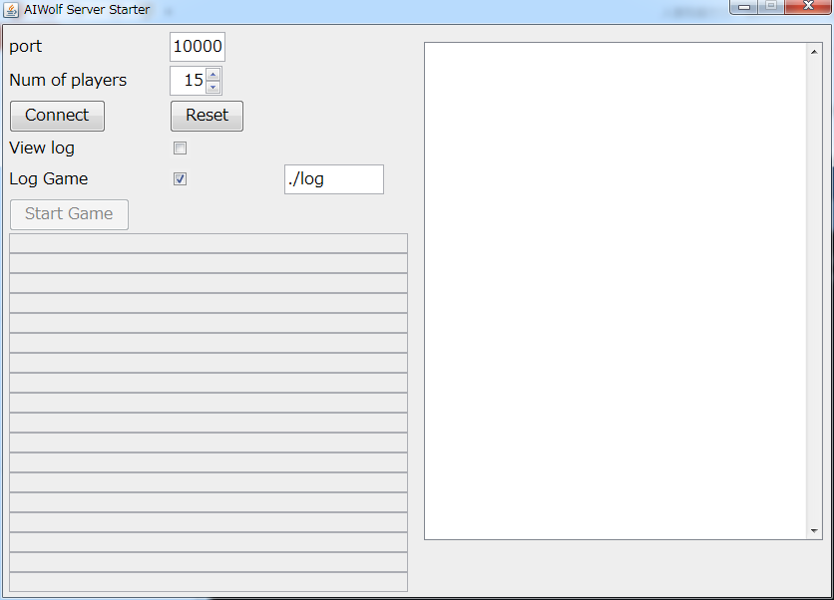
Run the game using GUI
Server Starter
Windows : Double-click StartServer.bat
Mac/Linux : Double-click StartSerber.sh

Slide 90
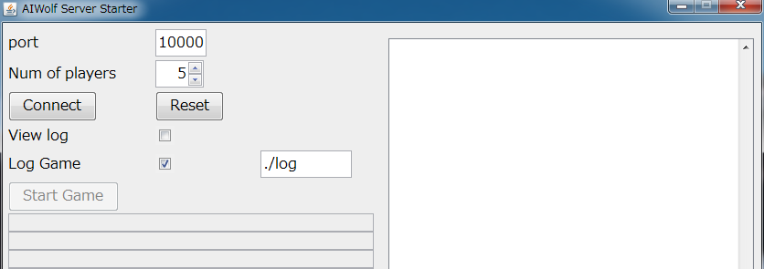
Configure server
Num of players = 5
Click [Connect]

Slide 91
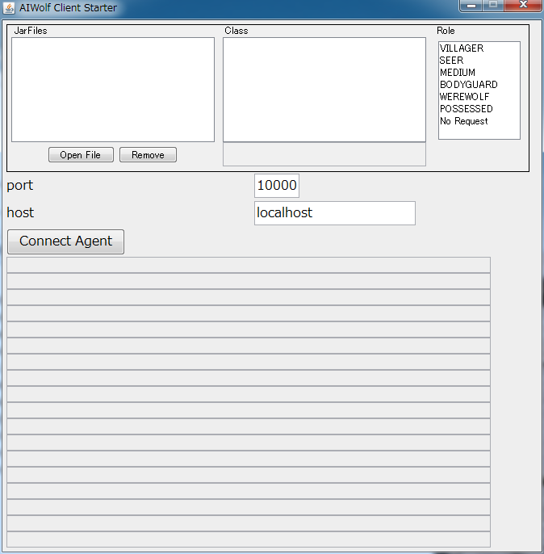
Connect clients(1/3)
Client Starter
Windows : Start StartGuiClient.bat
Mac/Linux : Start StartGuiClient.sh

Slide 92
Connect clients(2/3)
Copy Jar and aiwolf-client.jar to JarFiles

Slide 93
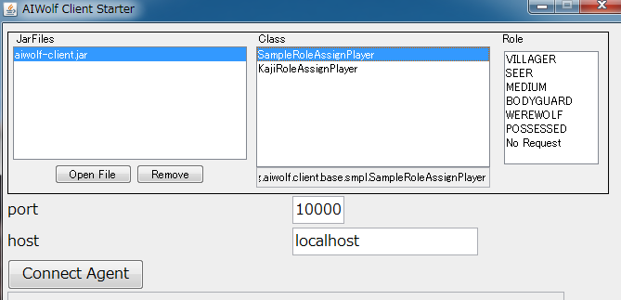
Connect clients (3/3)
Select JAR，player class
Select Connect Agent
You can also request by using Role

Slide 94
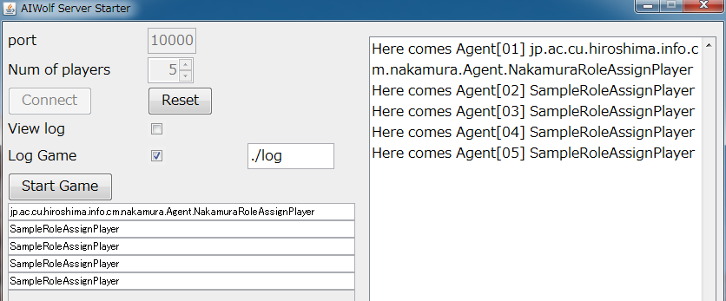
Run the game
Your own agent v.s. SampleRoleAssignPlayer
Server Starter ＞ Click [Start Game]
5 Agent connected（ServerStarter）

Slide 95
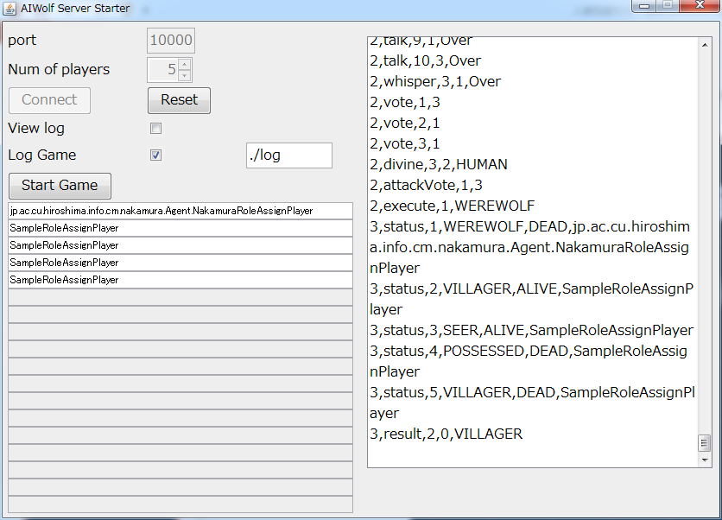
Result
You can see the result on right window
Example : (Villager) won

